Slide 1
New features in OAS 6.4 for Alma and Primo Data Visualization
Yoel Kortick – Senior Librarian

Slide 2

Contents
  Introduction
  Projects are now called “Workbooks”
  Add notes to a workbook
  Connect a Note to Data Points in a Visualization
  Additional visualizations
  List Box (using a prompt in a workbook)
  List Box properties
  Conditional formatting
  Export a specific visualization from within a workbook

Slide 3
Introduction

Slide 4
OAS 6.4
During Sept. to Dec. 2022 the current OAS (Oracle Analytics Server) is being upgraded to OAS 6.4.
This presentation will highlight selected new features in OAS 6.4 and how they apply to Alma and Primo Data Visualization.
See also What’s new for Oracle Analytics Server

Slide 5
Projects are now called “Workbooks”

Slide 6
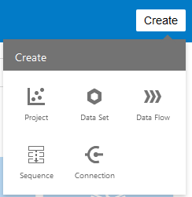
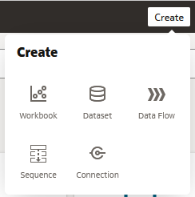
Projects are now called “Workbooks”
Before OAS 6.4
OAS 6.4

Slide 7
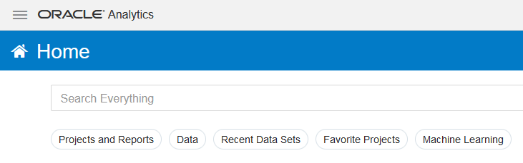
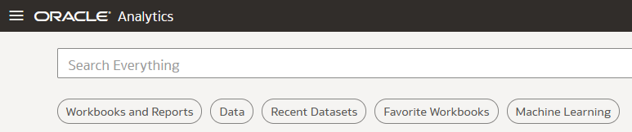
Projects are now called “Workbooks”
Before OAS 6.4
OAS 6.4

Slide 8
Add notes to a workbook

Slide 9
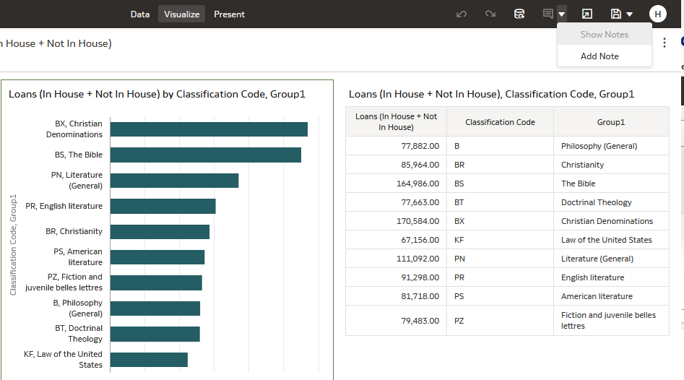
Add notes to a workbook

Slide 10
Add notes to a workbook
You can add notes to point out important information in a workbook's visualizations.
The notes can be used to annotate one or all of the visualizations in a canvas, or to emphasize specific data points in a visualization (for example a column in a table).
There are many formatting options that can be used to customize a note's content. For example, font type, size, and color. Also bulleted or numbered lists can be used, as well as hyperlinks.
When a note is added it can also have a data connectors to call out specific points in the visualization

Slide 11

Add notes to a workbook
To add a note (without data point connectors), click the Notes icon and select Add Note.

Slide 12
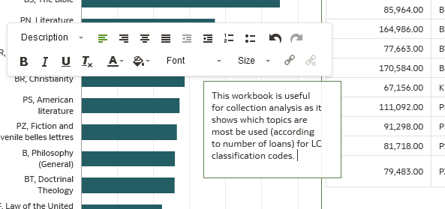
Add notes to a workbook
In the note box, enter the note text and use the formatting options to specify the note's font style, color, size, and so on.
Formatting options
Note box

Slide 13
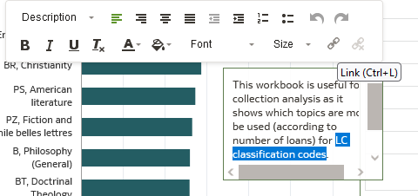
Add notes to a workbook
Optional: To add a link to the note, highlight the note text that you want to make into a link and then click “Link”. In the Hyperlink dialog, enter a URL.
Click Link
Select text

Slide 14
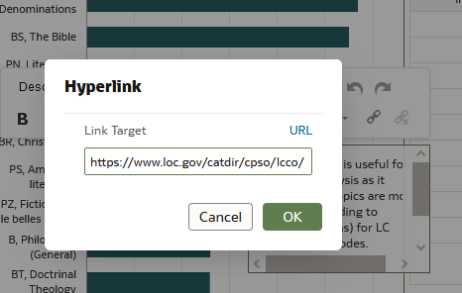
Add notes to a workbook
Optional: To add a link to the note, highlight the note text that you want to make into a link. Click Link and in the Hyperlink dialog, enter a URL. Click OK.
Enter URL
Click OK

Slide 15
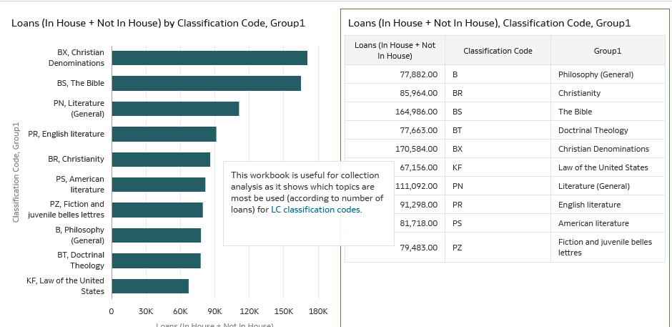
Add notes to a workbook
We now have a note in the workbook and it has a hyperlink
The hyperlink will by default open in a new tab

Slide 16
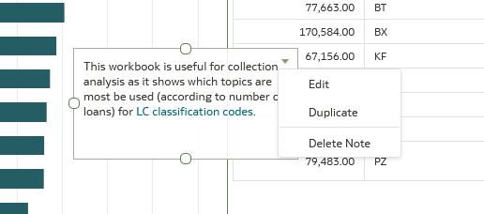
Add notes to a workbook
To duplicate, edit or delete a note hover over the note and click the down arrow on the top right of the note

Slide 17
Connect a Note to Data Points in a Visualization

Slide 18
Connect a Note to Data Points in a Visualization
It is also possible to connect a note to Data Points in a visualization.
This is useful if the note pertains to one specific data point, and it will be useful for the consumer of the workbook to be aware of which data point is relevant for the note.
It is possible to connect a note to up to ten data points on a visualization or canvas.

Slide 19
Connect a Note to Data Points in a Visualization
Note that it is not possible to connect a note to a data point on these visualization types:
  Chord Diagram
  Correlation Matrix
  List
  Map
  Parallel Coordinates
  Tile

Slide 20
Connect a Note to Data Points in a Visualization
To connect a note to a data point:
Locate and hover over the note.
Click and hold a circle
Drag the line to the data point that you want to connect the note to.

Slide 21
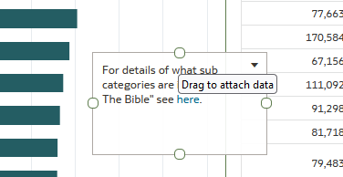
Connect a Note to Data Points in a Visualization
Locate and hover over the note.
Click and hold a circle

Slide 22
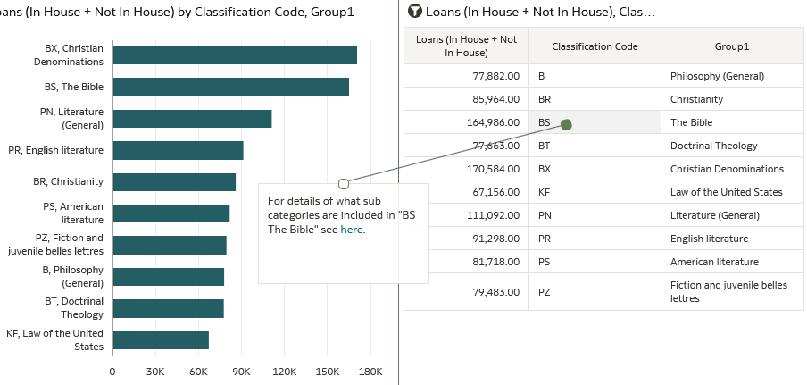
Connect a Note to Data Points in a Visualization
Drag the line from the circle to the desired data point

Slide 23
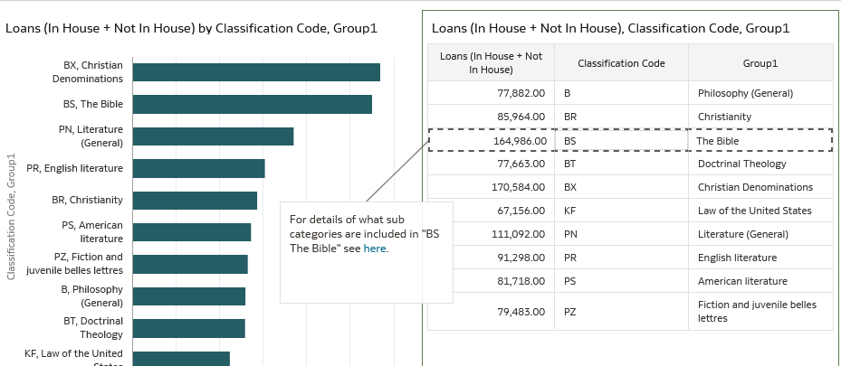
Connect a Note to Data Points in a Visualization
Now we have a line from the note to the data point

Slide 24
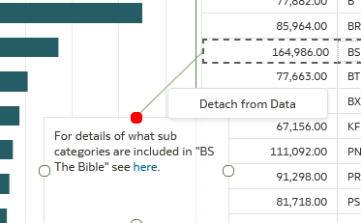
Connect a Note to Data Points in a Visualization
To remove the line right click it and select “Detach from Data”.

Slide 25
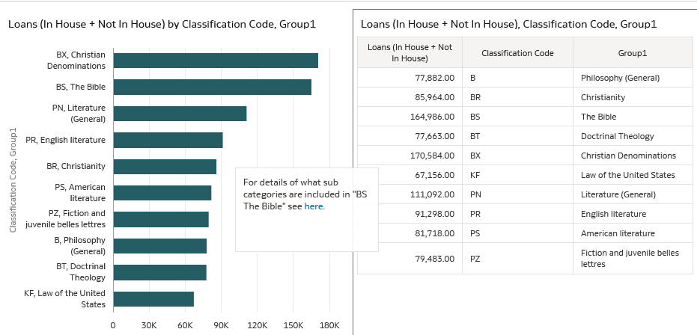
Connect a Note to Data Points in a Visualization
Now the connecting line is gone

Slide 26
Additional visualizations

Slide 27
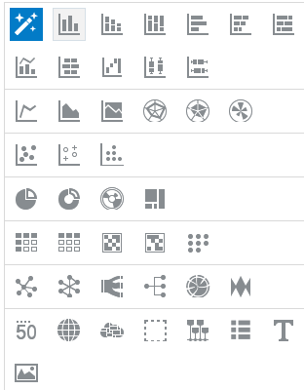
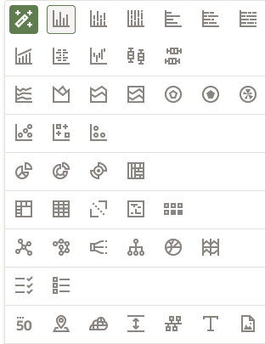
Additional visualizations
Visualizations before OAS 6.4
Visualizations after OAS 6.4
Stacked Area
List Box

Slide 28
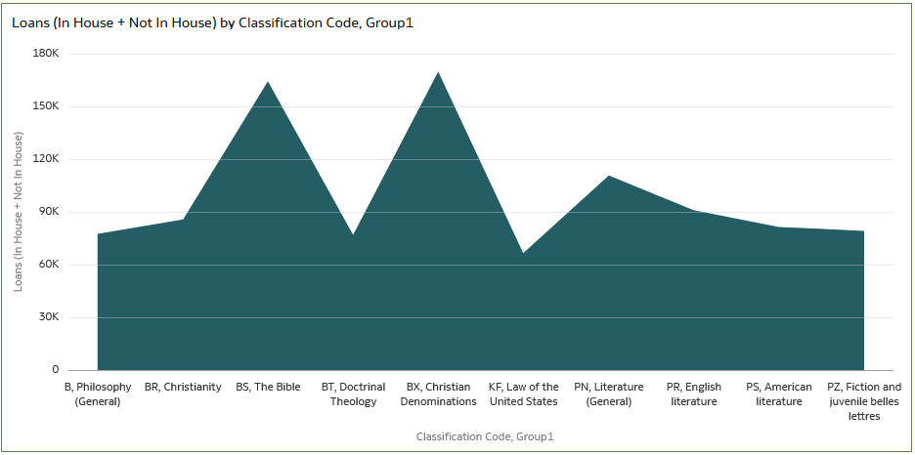
Additional visualizations
Stacked Area

Slide 29
Additional visualizations
We will look at “List Box” as a separate dedicated section.

Slide 30
List Box (using a prompt in a workbook)

Slide 31
List Box (using a prompt in a workbook)
The “List Box” allows the consumer of the Data Visualization workbook to choose a specific value or values which can apply to the entire workbook.
In this sense it is similar to a “Prompt” in the Alma Analytic reports and dashboards.
Note that there are many ways to use the “List Box” and here we are showing only one way.

Slide 32
List Box (using a prompt in a workbook)
On the next slide we have a workbook using the “Usage Data” subject area.
It filters by 10 specific platforms and displays the platform name and the measure “TR_B1 – Total item requests”.
There are two visualizations: one is a table, and one is bar graph.
We drag in the “List Box” visualization from the data panel.

Slide 33
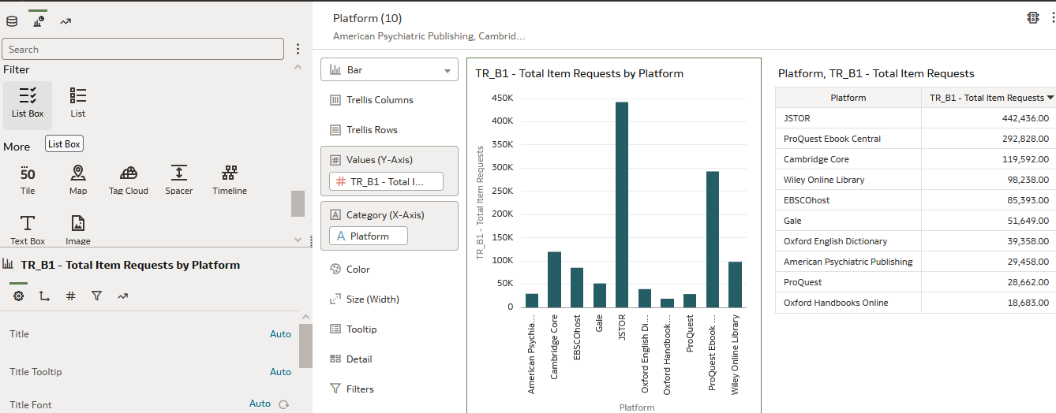
List Box (using a prompt in a workbook)

Slide 34
List Box (using a prompt in a workbook)
On the next slide the “List Box” has been added.

Slide 35
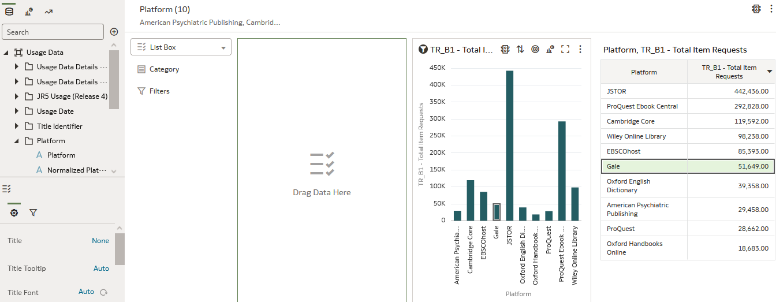
List Box (using a prompt in a workbook)
This is the List Box
We will drag the “Platform” onto the “List Box” where it states “Drag Data Here” and put it in the “Category”

Slide 36
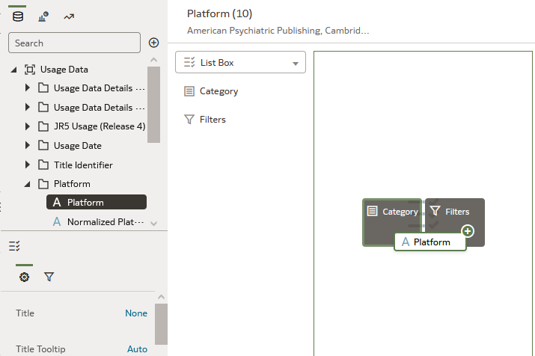
List Box (using a prompt in a workbook)
We have dragged the “Platform” onto the “List Box” and put it in the “Category”

Slide 37
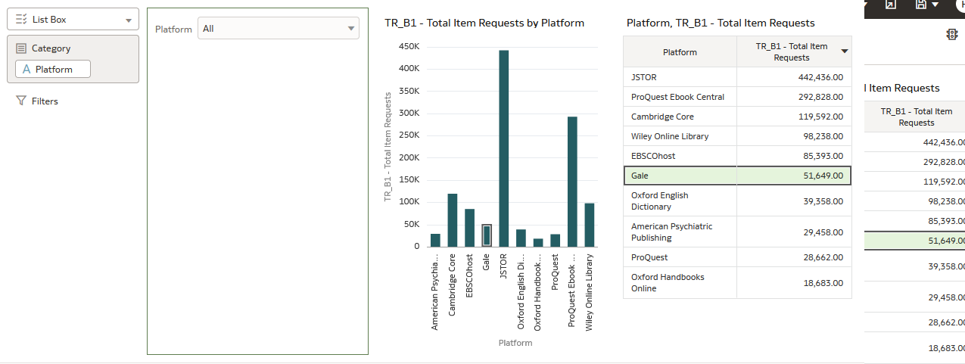
List Box (using a prompt in a workbook)
Here the workbook consumer can perform a filter
“Platform” is in the “Category”

Slide 38
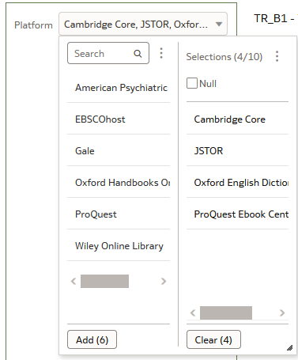
List Box (using a prompt in a workbook)
Using the “List Box” the workbook Consumer has chosen four specific platforms as a filter

Slide 39
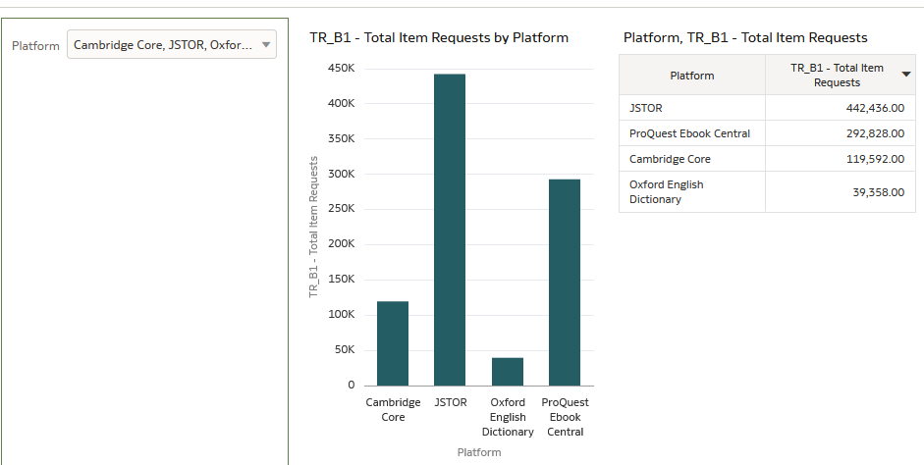
List Box (using a prompt in a workbook)
Now the entire workbook is filtered by the four specific values.
Both the table and graph are filtered according to what was chosen in the list box

Slide 40
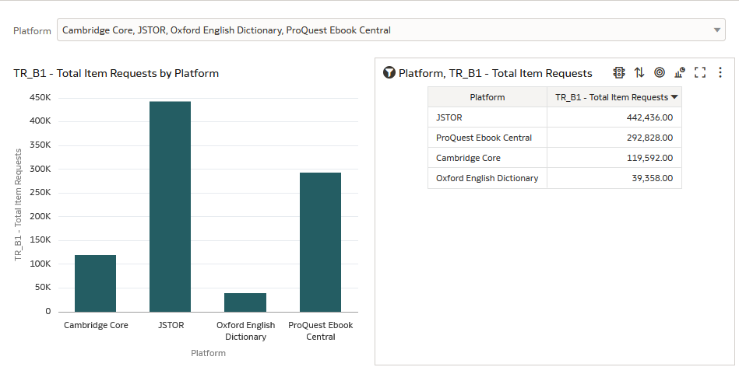
List Box (using a prompt in a workbook)
For aesthetic purposes we will probably want to move (drag) the List Box to the top

Slide 41
List Box properties

Slide 42
List Box properties
On the next slide we have a workbook named “Usage data TR_B1 Total Item Requests per platform for 2022”.
It displays the measure “TR_B1 Total Item Requests” and attribute “Platform”.
It filters by “Usage Date Year = 2022” “TR_B1 Total Item Requests >= 1000”
It displays a table and graph

Slide 43
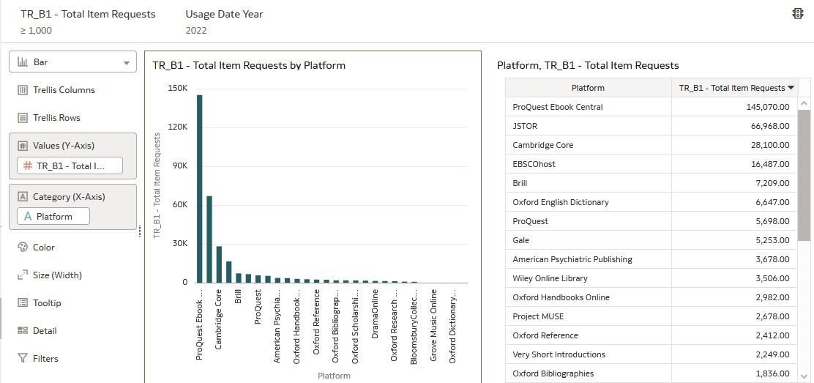
List Box properties

Slide 44
List Box properties
On the next slide we have added a List Box to the top but not yet added any measures or categories to the List Box

Slide 45
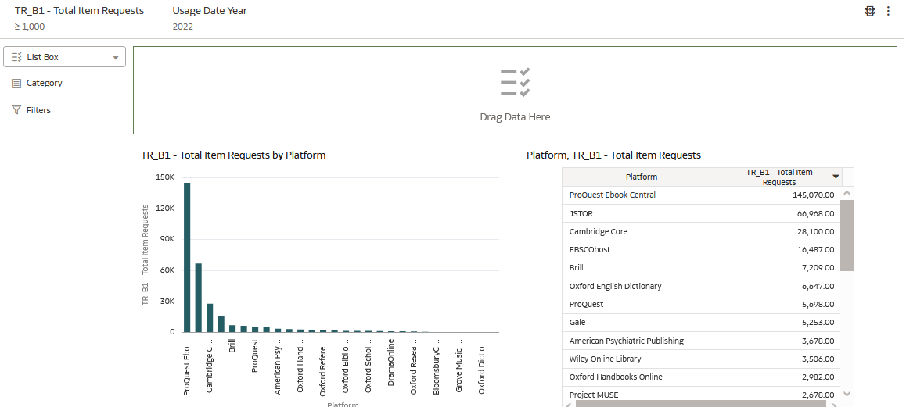
List Box properties

Slide 46
List Box properties
On the next slide we have added the platform to the category of the List Box.
It by default contains all Platforms (taking into account the filters on the workbook)

Slide 47
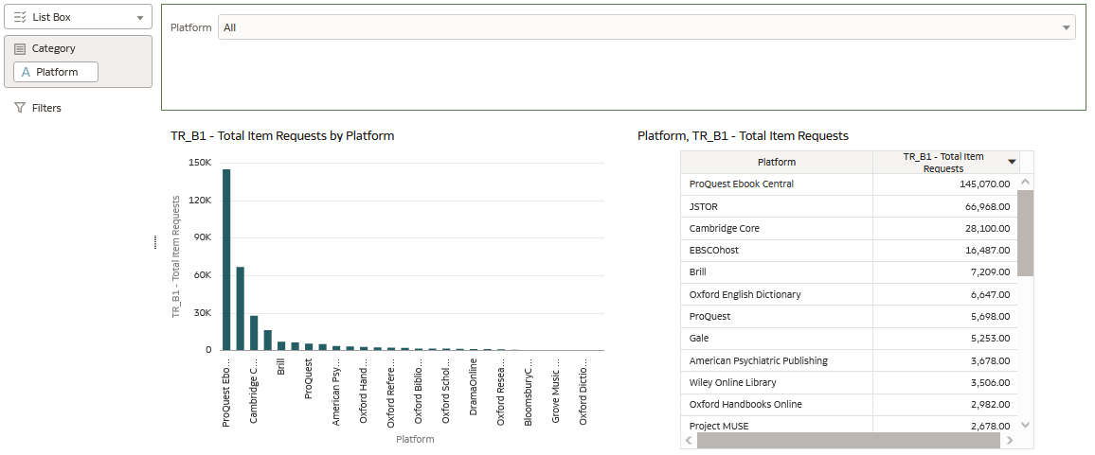
List Box properties

Slide 48
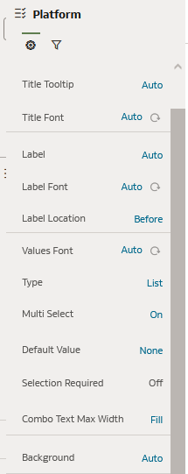
List Box properties
While selecting the List Box in the workbook we can see on the bottom left a list of properties for the List Box
We will click “Auto” next to “Background” to change it from “Auto” to “Custom”

Slide 49
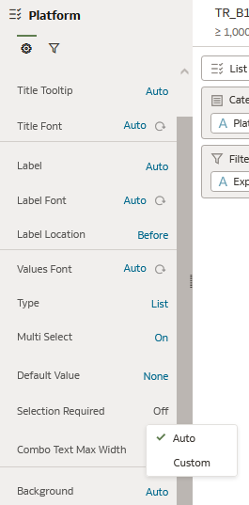
List Box properties
We will choose “Custom”

Slide 50
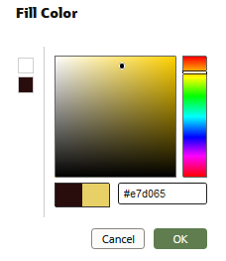
List Box properties
Then we click “Fill Color” and choose a color

Slide 51
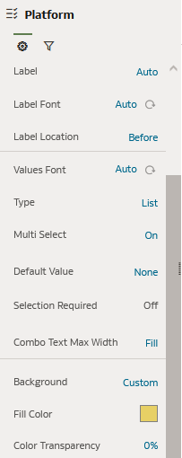
List Box properties
Now the properties look like this

Slide 52
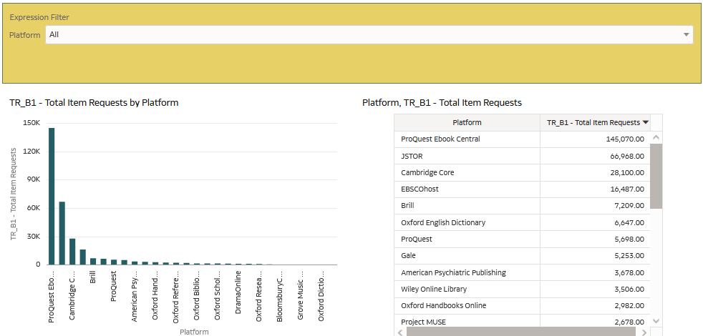
List Box properties
And here is the workbook

Slide 53
Conditional formatting

Slide 54
Conditional formatting
Conditional formatting helps to highlight trends in data.
The workbook designer can create rules that determine the format of cells based on their values.

Slide 55
Conditional formatting
On the next slide we have a workbook in the “Primo Popular Searches” subject area of Primo Data Visualization.
It includes the top 15 search strings which contain the word “engineering”.
There are two visualizations: a graph and a table

Slide 56
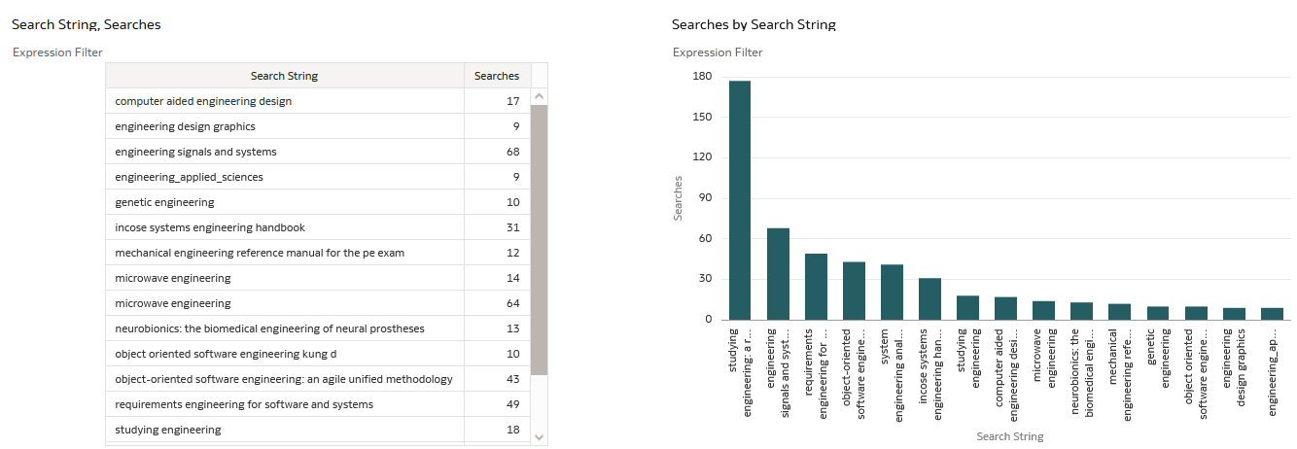
Conditional formatting

Slide 57
Conditional formatting
On the table visualization we will hover over the top of the visualization and click the stop light icon which has tooltip “Manage Conditional Formatting Rules”.
Then we will create a rule that states “If the number of searches is greater than 30 then make it red bold”

Slide 58
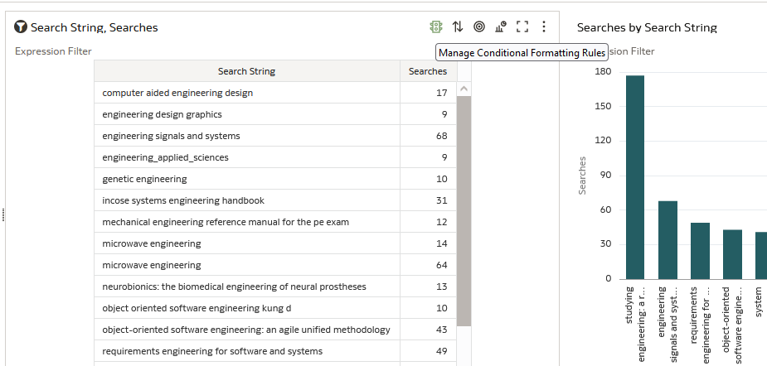
Conditional formatting

Slide 59
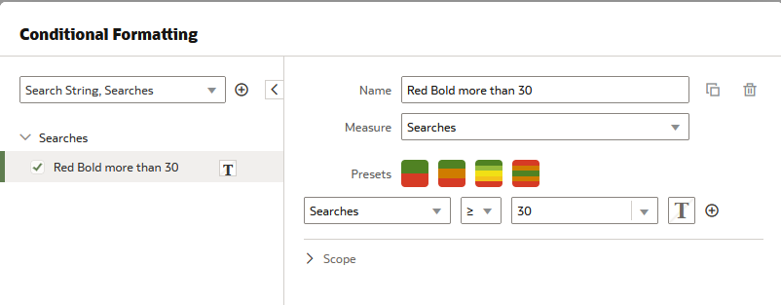
Conditional formatting
The rule is named “Red Bold more than 30” and it works on the measure “Searches”
Here we have stated “If the number of searches is greater than or equal to 30”
Now we will click here to determine the format of the field when it is greater or equal to 30

Slide 60
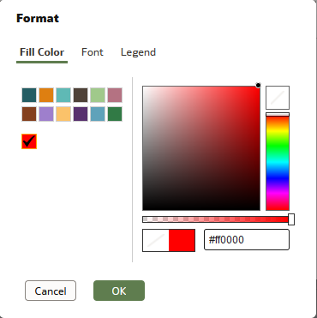
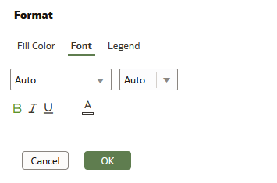
Conditional formatting
Now we choose the color and font

Slide 61
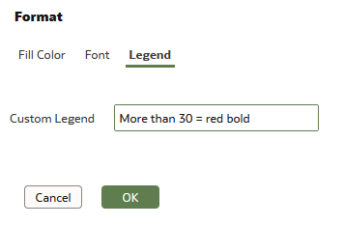
Conditional formatting
We can also make a legend
This will be our legend

Slide 62
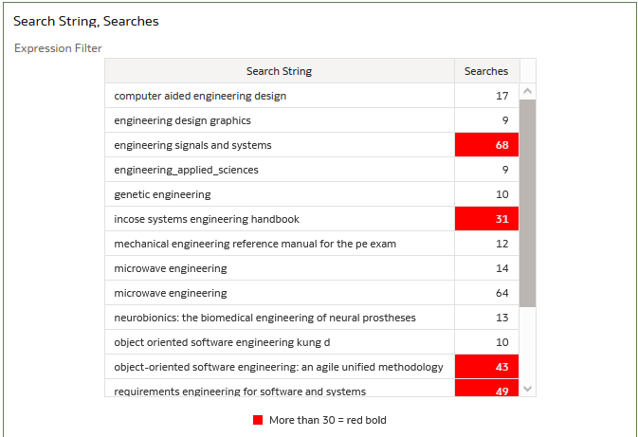
Conditional formatting
After saving the conditional formatting rule we now have this
Anything 30 or greater is red bold.
Here is the legend

Slide 63
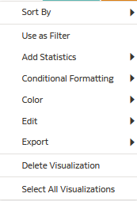
Conditional formatting
Note that it is also possible to add conditional formatting by right clicking on a visualization

Slide 64
Export a specific visualization from within a workbook

Slide 65
Export a specific visualization from within a workbook
Before OAS 6.4 it was possible to export an entire workbook (called “project” before OAS 6.4) but it was not possible to export just one visualization in the workbook.
Now it is possible to export either the entire workbook or just one visualization in the workbook.
This is useful if it is desired to share a visualization in the workbook, and not all visualizations in the workbook are needed for the export.

Slide 66
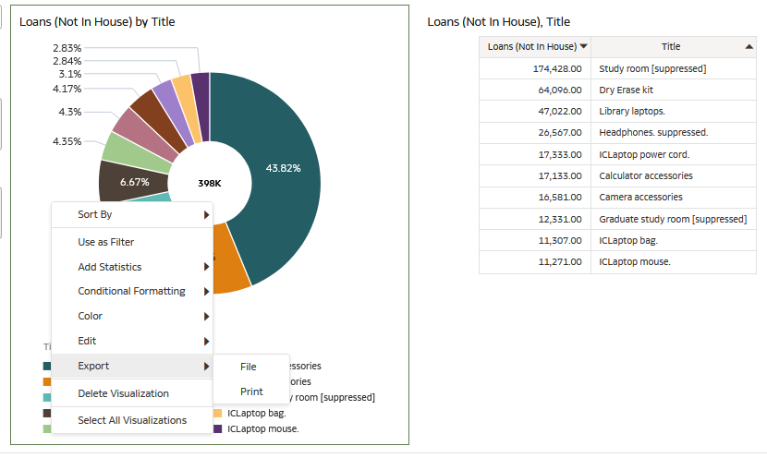
Export a specific visualization from within a workbook
Here in OAS 6.4 we right click the left visualization and can export it

Slide 67
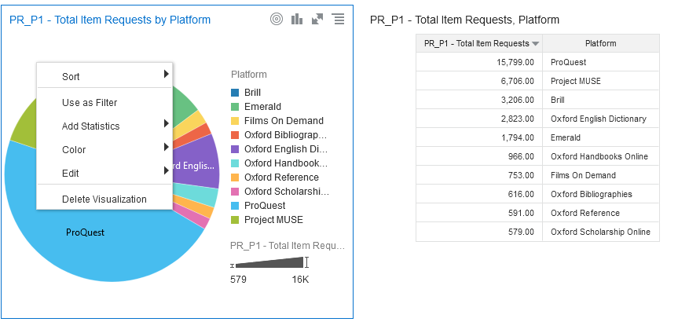
Export a specific visualization from within a workbook
Here before OAS 6.4 we right click the left visualization and cannot export it

Slide 68
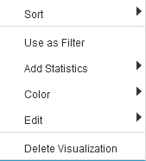
Export a specific visualization from within a workbook
Right click on visualization before OAS 6.4
Right click on visualization after OAS 6.4

Slide 69
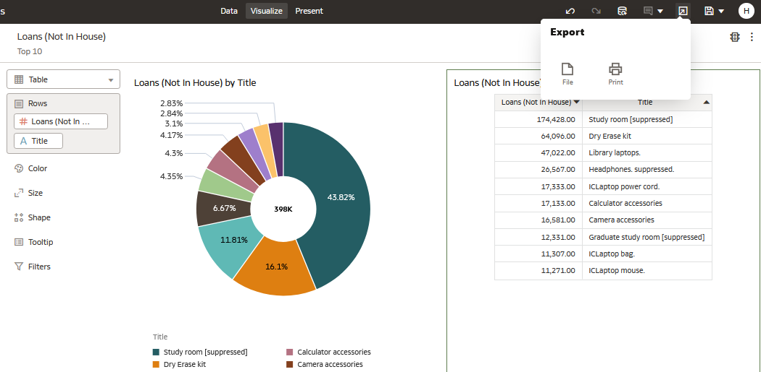
Export a specific visualization from within a workbook
From here we can export the entire visualization

Slide 70
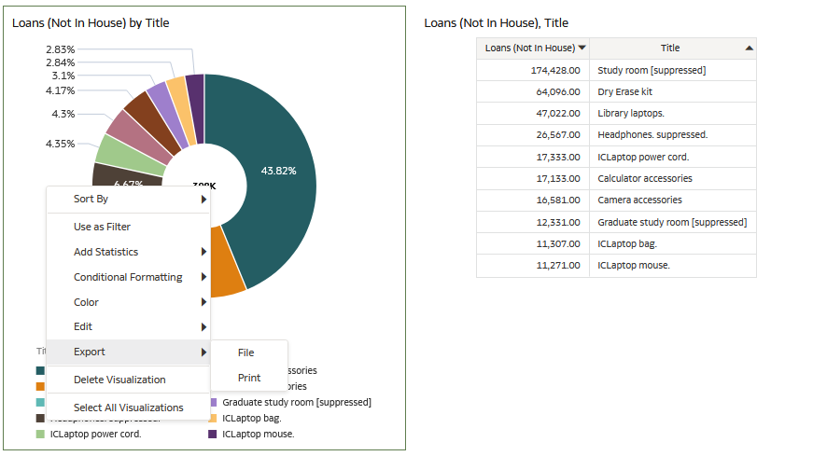
Export a specific visualization from within a workbook
We will export only the left visualization to a file

Slide 71
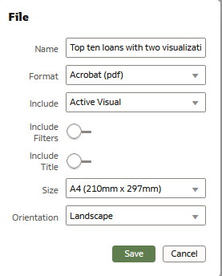
Export a specific visualization from within a workbook
We will export to Adobe Acrobat

Slide 72
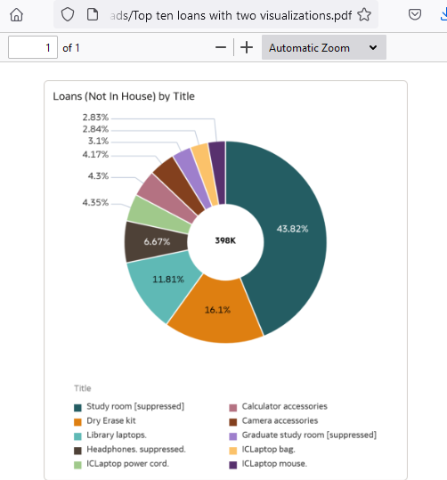
Export a specific visualization from within a workbook
Here is the pdf of the single visualization

Slide 73
xxx@exlibrisgroup.com

